Slide 1


CORPORATE PRESENTATION
Unlocking High-Integrity Carbon Markets & Net Zero Pathways
Policy · Finance · Advisory · Digital Innovation
UNMAI CARBON SOLUTIONS SINGAPORE
Singapore · India · Global Carbon Market Delivery
T³I: Truth · Transparency · Traceability · Integrity
www.unmaicarbon.earth

Slide 2




About UNMAI Carbon
Singapore-headquartered climate advisory and carbon solutions firm building trust infrastructure for global carbon markets.
Singapore HQ, global reach
> 20
A climate advisory and solutions firm working with governments, corporates and carbon market stakeholders, globally.
Article 6 and carbon market assignments delivered
> 14
Unlocking high-integrity carbon markets
High-integrity frameworks, climate finance mechanisms and digital infra that turn claims into verifiable tonnes.
3
Countries engaged across the team's track record
Policy , finance, advisory and digital
Regions: Asia, Middle East & Gulf, Africa
6
Tailored solutions across decarbonisation, net zero and carbon markets, from national strategy to market infrastructure.
5*
Countries in the flagship Article 6 Accelerator
Partnership-led delivery
Working with institutions such as TERI and embedding national experts.
Carbon Market Digital Products​
UNMAI is a Tamil word for truth: the principle behind everything we build.
* Under final stages of award
www.unmaicarbon.earth

Slide 3
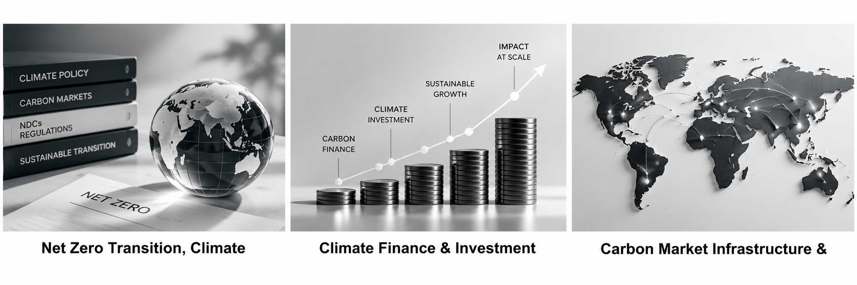

UNMAI Carbon Services: Three Pillars
Integrated advisory , finance and infrastructure for governments and corporates
Net Zero Transition, Climate Policy & Carbon Market Advisory
Climate Finance & Investment Strategy
Carbon Market Infrastructure & Governance
  Net zero strategies for governments and corporates
  Long-term climate policy design (NDCs, LT-LEDS, CBAM readiness)
  Sectoral decarbonisation planning and pathway development
  Capacity building and institutional readiness programmes
  Structuring results-based finance and carbon-linked instruments
  Policy and investment advisory for scaling carbon finance
  ESG and impact-driven capital mobilisation strategies
  Support for MRV-aligned financing mechanisms
  Design of national and subnational carbon market frameworks
  Article 6 readiness and cooperative approaches
  Blockchain-enabled trust architecture for registries and MRV interoperability
  Support for climate data standardisation and infrastructure governance
1
2
3
www.unmaicarbon.earth

Slide 4
UNMAI Carbon : Strengths & Capabilities
Article 6 & Carbon Markets
Climate Finance & Blended Finance
NAMBĪ dMRV Platform
50+ years of combined professional carbon market expertise. UNFCCC Article 6.2 and 6.4 advisory to 15+ governments including Bhutan, Mongolia, Philippines, Tanzania, Iraq, Oman, Pakistan, and Papua New Guinea.
Track record structuring blended finance vehicles: carbon-linked bonds, decarbonisation fund, credit guarantees, and philanthropic funds for climate projects / initiatives
UNMAI built NAMBĪ (www.nambi.earth)
— a digital MRV platform as a digital
public good, aggregating dMRV data and dMRV marketplace for credible carbon measurement at scale and methodology access
Institutional Relationships
Global Regulatory & Policy & Standards Advisory
Deep engagement with ADB, World Bank, UNDP, UNFCCC, and bilateral climate funds. Listed on ADB, UNFCCC & WB with extensive carbon market experience across 16+ countries.
Active carbon advisor on various carbon standards, carbon pricing, UNFCCC, and carbon price guarantee mechanisms. UK PACT, ADB CAREC and other engagements.
50+ Years Professional Experience
Asia & Africa Market Expertise
Digital Innovation Leadership
14+ Countries Engaged
Deep understanding of global carbon landscape combined with access to global carbon finance, Article 6 architecture, and voluntary carbon markets.
www.unmaicarbon.earth

Slide 5
Key Activities & Pipeline
Six live lines of work spanning strategy, finance, markets and digital infrastructure
Decarbonisation
Carbon Advisory
Carbon Financing
Development of net zero strategies for Indian corporates. (serving TATA Sons Group in consortium with Grant Thorton)
Cookstoves, CBG, AWD, BESS, biochar, bamboo, peatland protection and mangrove restoration.
Working with trading firms (UK and Singapore) and buyers (EU and USA).
Article 6
Carbon Digital Infrastructure
Carbon Trading
Carbon expert for ADB / UNFCCC on Article 6 technical assistance for Asian countries; supporting leading carbon market initiatives and designed Article 6 Accelerator (award stage)
National carbon registries (Nigeria, Asia), dMRV for e-mobility and nature-based solutions, marketplace and global carbon methodologies access Legacy UNFCCC CERs Platform.
CORSIA credits (Asia and Africa), Article 6 ITMOs (Asia and Africa) and VERs (USA, Africa and Asia).
www.unmaicarbon.earth

Slide 6
Article 6 : Closing the Execution Gap
What sets UNMAI apart: we build the operating system for carbon markets, not just advise on it
The Gap: Most programmes build policy knowledge and institutional frameworks. What is missing is execution: integrated support that connects policy design with investment preparation, bankable pipelines, market infrastructure and real transactions.
Policy & NDC alignment
Institutional coordination
Investment preparation
Project development
Market infrastructure
Private-sector engagement
Transaction structuring
UNMAI'S OPERATING MODEL
End-to-end platform
Central coordination unit
Investment pipeline intelligence
Transaction-ready pathway
Moves countries from readiness to project development, and from fragmented support to authorised transactions.
Concrete project identification and market-making that connects buyers and sellers with real pipeline data.
Buyer engagement materials, transaction templates and pilot pathways: from ambition to authorised transactions.
Embedded as a structural component, with a government and private-sector toolkit.
www.unmaicarbon.earth

Slide 7
Flagship: Article 6 Accelerator
An Article 6 readiness enabler for South and Southeast Asia: from NDC ambition to investment and transactions.
6
15
4
Countries (Phase 1)
Months: Oct 2026 – Dec 2027
Core deliverables
PARTICIPATING COUNTRIES
India · Pakistan · Bangladesh · Sri Lanka · Nepal · Bhutan · Maldives · Indonesia · Philippines · Lao PDR
COP31 regional launch
Authorisation Analysis
Toolkit & COP32 pipeline launch
OCT 2026
Public launch of the Accelerator, anchored and co-hosted with Bhutan.
Q1 2027
NDC-based assessment of what each country can and cannot authorise.
Q3 2027
Toolkit issued to agencies and developers; regional investment pipeline launched at COP32.
01
02
03
04
05
06
Scoping workshop, New Delhi
NOV 2026
Carbon Market Information Platform
Q2 2027
Investment Pipeline Intelligence
Q4 2027
Programme launch with all 10 country delegations; coordination established with India's MoEFCC.
Regional one-stop information layer goes live across all 10 countries.
Bankable activity identification and structured buyer–seller matching.
www.unmaicarbon.earth

Slide 8



NAMBĪ: A Digital Public Good for dMRV
Networked Architecture for MRV Benchmarking & Integrity · Implementation partner: UNMAI Carbon
A high-integrity, inclusive, Paris-aligned carbon market with harmonised data flows, scaling climate finance to net zero needs, access to global methodologies
VISION
As a Digital Public Good, aggregate, standardise and democratise dMRV solutions, embedding Trust, Transparency, Traceability and Integrity (T³I).
MISSION
OBJECTIVES
www.nambi.earth
Common data schemas and protocols
Harmonisation and interoperability
Open technical features for the public
A common dMRV data protocol, standard formats, decentralised identifiers and open APIs.
API-driven integration, schema mapping and dMRV-as-a-Service (dAAS) that bridge voluntary and compliance markets.
Open-source components, sandbox, documentation and training that build a transparent innovation ecosystem.
Why “NAMBĪ”? It connotes trust, faith and reliability, from the Tamil word nambikkai.
www.unmaicarbon.earth

Slide 9



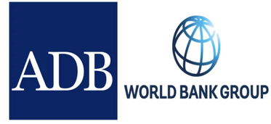




























Ecosystem & Strategic Partnerships
Building high-integrity carbon markets with research institutions, standards bodies and technology partners
Our select network
Select Institutions, standards bodies and partners across our pipeline and delivery work
Host of Partners from USA / Canada / UK / EU / Africa / Latin America / Asia
+
Kumi Analytics
Japan
Planetwise
G Infinity
www.unmaicarbon.earth

Slide 10









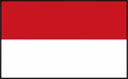
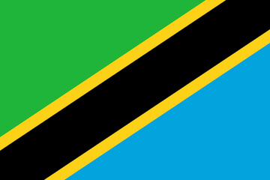


UNMAI Team Country Experience
Article 6 and carbon market assignments delivered more than 14 countries — policy, registries, platforms and finance
Asia
14
Middle East & Gulf
3
Africa & Horn of Africa
7
7
1
2
Positive list, carbon markets framework, information platform, climate fund, carbon-linked bond
Design of a domestic carbon market registry and emissions trading system
Digital carbon market platform; agricultural carbon markets and smallholder readiness
3
1
2
Authorisation of projects generating mitigation outcomes for inclusion under OIMP
National institutional framework to support Article 6 readiness
Carbon trading policy framework, digital market platform, Article 6 positive list
Carbon trading policy framework; Article 6 capacity building for NDC implementation
2
1
1
National carbon markets framework and national carbon market registry
National methane reduction implementation strategy for the livestock sub-sector
1
MRV advisory on quantification and accounting of eligible mitigation outcomes
REGIONAL FOCUS
1
Gulf engagements centre on market infrastructure and authorisation architecture — registry design, ETS mechanics and the decision rules that govern which mitigation outcomes a state is willing to authorise.
Carbon trading policy framework and guiding principles
1
Carbon market readiness and inputs to the Pakistan Carbon Market Rules
1
Carbon market readiness and strategies to leverage carbon assets
Other Countries : Fiji Island, India, CAREC Region
Carbon pricing, Projects evaluation, Registry, Climate Law review and A6 readiness assessment
14
Countries Engaged
24
Distinct Assignments
3
Regions Covered
2025 –2026
Delivery span
www.unmaicarbon.earth

Slide 11
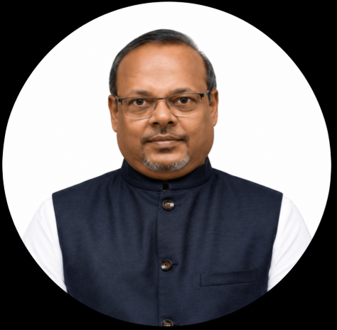
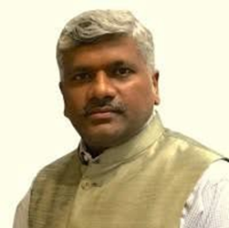
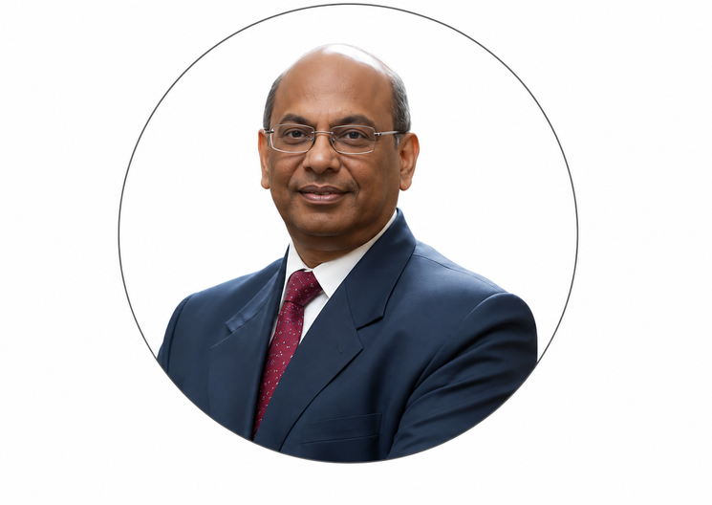


Leadership & Advisory
A senior core team and global Article 6 advisors
Yuvaraj
Dinesh Babu
Dr. Axel Michaelowa
Dr. Bhaskar Natarajan
Umamaheswaran
Dr. Ajay Mathur
FOUNDER & CEO
STRATEGIC PARTNER
ADVISOR
GLOBAL ADVISORY
GLOBAL ADVISORY
Global Climate Finance & Energy Transition Leader
Article 6 & Carbon Markets Expert
Global Clean Energy, Carbon Market & Climate Specialist
Global Carbon Markets and Energy Efficiency Expert
Global Climate Policy & Carbon Markets Expert
30 years with carbon market platforms, funds and multilaterals. Overall delivery accountability, country engagement and transaction structuring.
Day-to-day programme management, deliverables and platform build-out for the Article 6 Accelerator.
Strategic direction and institutional access across governments and multilateral partners.
Expert in carbon markets and international climate policy, with extensive experience in Article 6, CDM, and climate finance.
Carbon markets and industrial & buildings energy efficiency expert.
www.unmaicarbon.earth

Slide 12
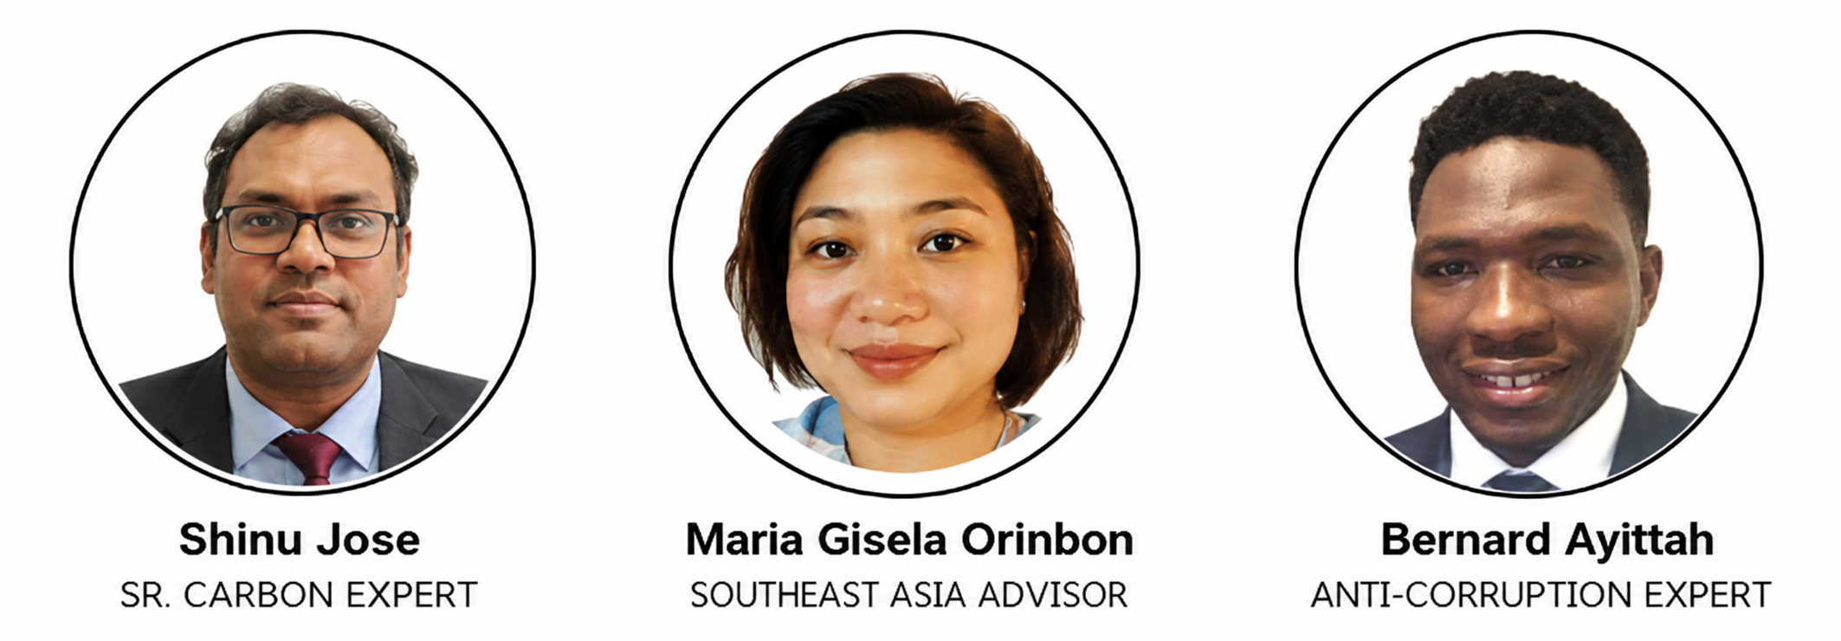


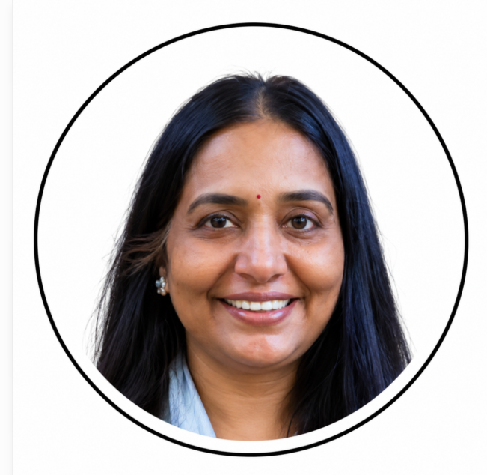

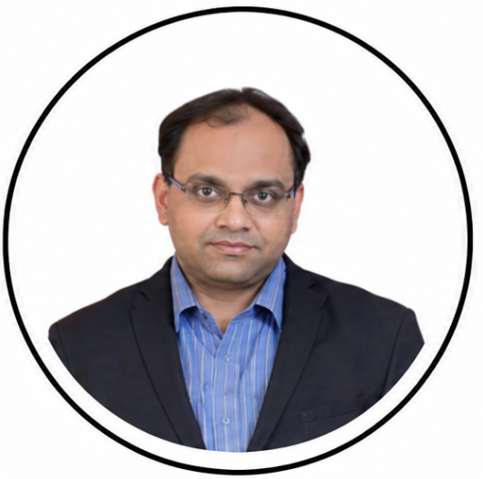

UNMAI Carbon Team
Carbon project, finance, market and digital specialists across Asia, Africa and the Middle East
Shinu Jose
Maria Gisela Orinion
Bernard Ayittah
Sharmin Shakeela
Rimi Pathak
SR. CARBON EXPERT
SOUTHEAST ASIAN CARBON MARKET EXPERT
AFRICAN CARBON MARKET EXPERT
PROGRAM COORDINATOR
CARBON MARKET & COMMUNICATIONS SPECIALIST
Carbon projects specialist. 15 years across biochar, CDR, forestry, blue carbon, clean energy and industrial credits.
Business development specialist. 21 years with ADB, climate and health, and programme management.
African carbon market and climate specialist. 10 years across carbon markets, energy and business development.
Experience in clean energy, carbon advisory, project origination, stakeholder engagement, and carbon credit market development in Bangladesh and other relevant jurisdictions.
Experience in carbon markets, communications, stakeholder engagement, and market outreach.
6
Embedded national experts
One expert in every Article 6 Accelerator country, the interface between the programme and each designated national authority.
Souvik
Boudhhayan Duttaa
Kotteswari
Nirmala
CARBON EXPERT
CBG BUSINESS HEAD
CHIEF DIGITAL OFFICER
CROSS-SECTOR MANAGEMENT EXPERT
Global carbon market specialist. 15 years across carbon markets, sustainability and business operations.
Business development specialist. 20+ years in sales leadership, operations and digital entrepreneurship.
Software specialist. 10+ years across clean energy, carbon markets, sustainability and business operations.
Experience in strategic partnerships, CSR advisory, women’s entrepreneurship, program design, and stakeholder engagement.
www.unmaicarbon.earth

Slide 13

Partner with us for
‘Integrity First’ Climate Solutions
We welcome the opportunity to support your organization across climate
policy, finance, decarbonization, and digital market infrastructure.
Yuvaraj Dinesh Babu Nithyanandam
ydb@unmaicarbon.earth
www.unmaicarbon.earth | +65 9023 1823
10, Sim Lim Tower, Jalan Besar #10-10, Singapore 208787
www.unmaicarbon.earth

Slide 14
Thank you!!!
UNMAI CARBON SOLUTIONS SINGAPORE
Singapore · India · Global Carbon Market Delivery
T³I: Truth · Transparency · Traceability · Integrity
www.unmaicarbon.earth

